Slide 1
CX002-3-3
Introduction to Web Programming
Web Modeling & Web Content Development

Slide 2
Web Development Process
Business Requirements
Requirement Specifications
Data Design
Hypertext Design
&
Content Management
Design
Implementation
Maintenance & Evolution

Slide 3
WDP – Requirements Specification
IN: business requirements
OUT: user-oriented, easy-to-understand, precise specification
Two(2) main activities are involved:
  1. Requirements Collection: general picture of the application domain and of the solution, by interviewing players and reviewing existing documentation
  2. Requirements Analysis: revision and formalization of the collected requirements
Output is useful for:
  Designers: understand what the application must do
  Stakeholders: validate the adherence of the specifications to the business requirements

Slide 4
WDP – Requirements Collection
Users identification: clustering of users in groups
Functional requirements: identification of processes that are supported by the application (through use cases or scenarios)
Personalization requirements: formalization of need of different content and services to different individuals, based on preferences and access rights
Device specific requirements.: for multi-device applications
Non functional requirements.: usability, performance, availability, scalability, security, maintainability

Slide 5
WDP – Non Functional Requirements
Usability: ease of use of the application
Performance: efficiency with which the application exploits the available resources, in terms of throughput (the number of requests that can be served per unit of time) and response time
Availability: tolerated frequency of errors and failures
Scalability: ability of increasing the performance of the application in response to the increase of the volume of requests
Security: protection of integrity, confidentiality and privacy of information, authentication of the users, protection of the information flowing between the users and the application
Maintainability: ease of repairing application errors and adapting the Web application to changed or new requirements

Slide 6
WDP- Requirement Analysis
Revision and formalization of the collected requirements, producing in output a set of semi-formal specifications, typically in term of:
  Use-case specification
  Data specification

Slide 7
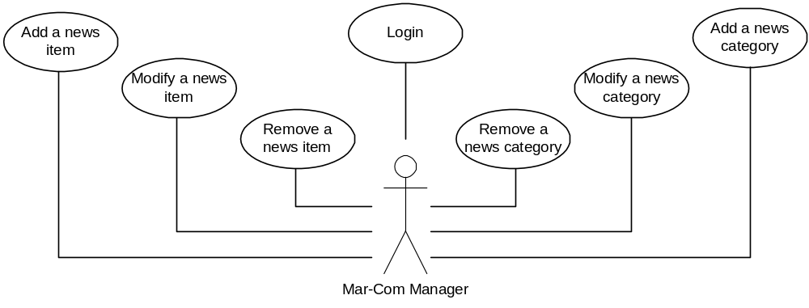
WDP – Use Case Specification
Use Case Diagram

Slide 8
Introduction to WebML
Data-intensive Web sites are applications devoted to the access of large amounts of structured data.
Design of data structures for storing content, the conception of hypertext interfaces for information browsing and content management, the creation of effective presentation styles, the assembly of robust and high-performance architectures, and the integration with legacy applications and external services.
WebML aims at providing a structured approach to the design of data-driven web sites.

Slide 9
Introduction to WebML
Objectives of the WebML design processes are:
  Expressing the structure of a Web application with a high-level description.
  Providing multiple views of the same content.
  Separating the information content from its composition into pages, navigation, and presentation.
  Modeling users and communities explicitly, to permit the specification of personalization policies and one-to-one applications.
  Enabling the specification of data manipulation operations for updating the site content.

Slide 10
Introduction to WebML
There are distinct models to design a data-intensive website:
  Data Model
    Describes the conceptual data organization; it is compatible with the Entity-Relationship model and UML class diagrams.
  Hypertext Model
    Enables the specification of the front-end of the application.
    The application is packaged into modularization constructs called site views.
    Each site-view is further subdivided into sub-modules (called areas).
    The hypertext topology of each module is specified in terms on pages, is made of content elements, and links.

Slide 11
Introduction to WebML
There are distinct models to design a data-intensive website:
  Content Management Model
    Extends the hypertext model with simple constructs such as operations and transactions, enabling the invocation of predefined operations (E.g., insertion, deletion and modification of objects)

Slide 12
Target of WebML
Target of WebML is for data intensive web sites.
  Large amount of data
  Require personalization of content
WebML is not the right modeling tool for:
  Small web sites
  Static web sites

Slide 13
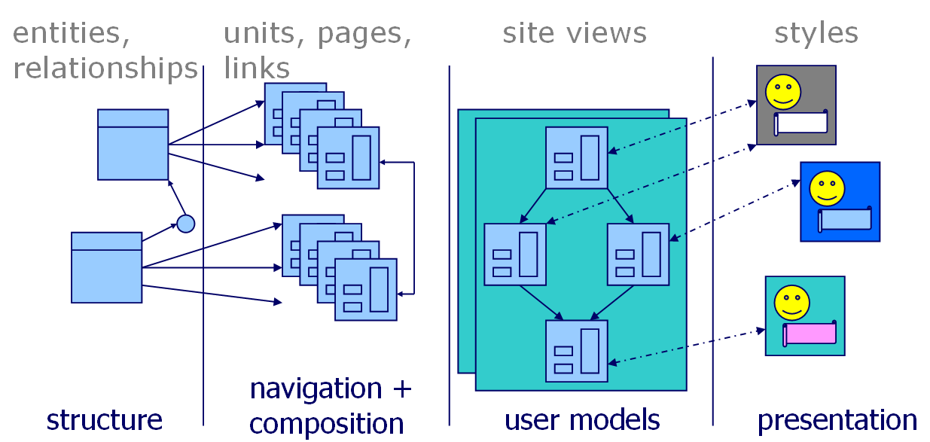
Preview of WebML Concepts
Website
Structure + Composition + Navigation + Presentation

Slide 14
Data Modeling
Data modeling language used in WebML is the Entity-Relationship (E-R) model.
Conceptual data model used in WebML, which includes data types, attributes, entities and relationships.
Structure model consist of:
  Entities
  Attributes
  Relationships
  ISA hierarchies

Slide 15
Data Modeling: Entities
An entity represents a description of the common features of set of objects of the real world. (E.g. Person, Table, Car).
They are denoted by means of rectangles, with the entity name at the top.
Album
Artist

Slide 16
Data Modeling: Attributes
Attributes represent the properties of real world objects that are relevant for the application purposes. (E.g. name, address, photo of a person).
Attributes are associated with entities.
Attributes are graphically represented inside the entity box, below the entity name.
Album
Artist
Title
Year
Cover
FirstName
LastName
Photo

Slide 17
Data Modeling: Attributes
To express the unique identity of entity instances, one or more attributes can be defined as the primary key of the entity.
It is good practice to define the primary key of entities using a single special purpose attribute, called object identifier (abbreviated as OID).
Attributes can be typed, which means that they assume values from well-defined domains, like for instance the set of integer or floating point numbers.

Slide 18
Data Modeling: Attributes
Entity-Relationship model permits the designer to organize entities into a hierarchy, where they share some common features and this is known as generalization hierarchy (Also called IS-A hierarchy).
Has one super-entity and many sub entities.
Artist
FirstName
LastName
Photo
Pop Artist
Jazz Artist

Slide 19
Data Modeling: Relationships
Relationships represent semantic connections between entities, like the association between an artist and his/her album, or between an artist and his/her reviews.
For example, the relationship between an artist and the albums he/she has published could be named “Publication”.
Relationships involving more than two entities, are called N-ary relationships.
Each binary relationship is characterized by two relationship roles, For example, the relationship publication between an artist and his/her album can be decomposed into two relationship roles:
  One from artist to album, named Publishes.
  One from album to artist, named Published By.

Slide 20
Data Modeling: Relationships
Relationship roles can be annotated with:
  minimum and maximum cardinality constraints.
It denotes the minimum and maximum number of objects of the destination entity to which any object of the source entity can be related.
Relevant values for the minimum cardinality are zero or one.
Relevant values for maximum cardinalities are one or many, the second option being denoted as “N”.

Slide 21
Data Modeling: Relationships
Based on their maximum cardinality constraints, relationships are called:
  One-to-one, if both relationships roles have maximum cardinality 1,
  One-to-many, if one relationship role has maximum cardinality 1
  Other role has maximum cardinality N, or “many-to-many”, if both relationships roles have maximum cardinality N.
Album
Artist
Publication
1:1
0:N
Graphic notation for relationships.

Slide 22
Data Modeling: Relationships
Album
1:1
Publication
0:N
Artist
Published_By
Publishes
Graphic notation for relationships roles.

Slide 23
Data Modeling: Relationships
Supplier
SupplierName
0..N
1..1
Part
Supply
Department
0..N
1..1
PartNumber
Value: Integer
DeptCode
1..1
0..N
Data schema with a N-ary relationship, represented by the entity Supply.

Slide 24
Hypertext Modeling
Hypertext modeling is to specify the organization of the front-end interfaces of a Web application.
Specifies actual hypertext topology of each module in terms of:
  Pages
  Content element linked to further support user’s navigation and interaction.
Hypertext modeling allows the developer to expand the data schema of the application with the specification of the hypertexts used for publishing and manipulating data.

Slide 25
Hypertext Modeling
The key ingredients of WebML are pages, units, and links, organized into modularization constructs called areas and site views.
Units are the atomic pieces of publishable content; they offer alternative ways of arranging the content dynamically extracted from the entities and relationships of the data schema, and also permit the specification of data entry forms for accepting user input.
Units are the building blocks of pages, which are the actual interface elements delivered to the users.

Slide 26
Hypertext Modeling
Page and units do not stand alone, but are linked to form a hypertext structure.
Hypertext modeling:
  They express the possibility of navigating from one point to another one in the.
  Hypertext, and the pass of parameters from one unit to another unit, which is required for the proper computation of the content of a page.

Slide 27
Hypertext Modeling : Units
WebML supports five type units:
  Data units: show information about a single object.
  Multidata units: present information about a set of objects.
  Index units: show a list of descriptive properties of some objects, without presenting their detailed information.
  Scroller units: enable the browsing of an ordered set of objects, by providing commands for accessing the first, last, previous, and next element of a sequence.
  Entry units: model entry forms, whose fields allow gathering input, needed to perform searches or to feed update operations.

Slide 28
Hypertext Modeling - Units
DATAUNIT
INDEXUNIT
MULTIDATAUNIT
ENTRYUNIT
SCROLLERUNIT
MULTICHOICE
HIERARCHICAL

Slide 29
Hypertext Modeling : Content Units
DATAUNIT
INDEXUNIT
MULTIDATAUNIT
Author
first name:XXX
last name:YYY
photo:
Index of Authors
All Authors
S. Ceri
P. Fraternali
O.Versand
ENTRYUNIT
SCROLLERUNIT
MULTICHOICE
HIERARCHICAL
Insert Your Data
Browse Authors
Choose Authors
Books&Authors
Fname
Lname
1. Web Applicat.
Ceri
Fraternali
2. Systems
Tannenbaum
5/12: go to
  
Ceri
Fraternali
Versand
1/12

Slide 30
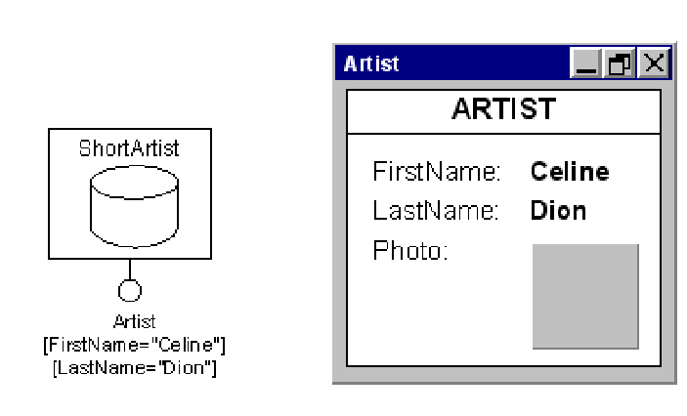
Hypertext Modeling : Units
WebML graphic notation for data units, and rendition in HTML.
Textual Definition
DataUnit ShortArtist
(source Artist;
selector FirstName="Celine", LastName="Dion";
attributes FirstName, LastName, Photo)
Data units publish a single object of a given entity.

Slide 31
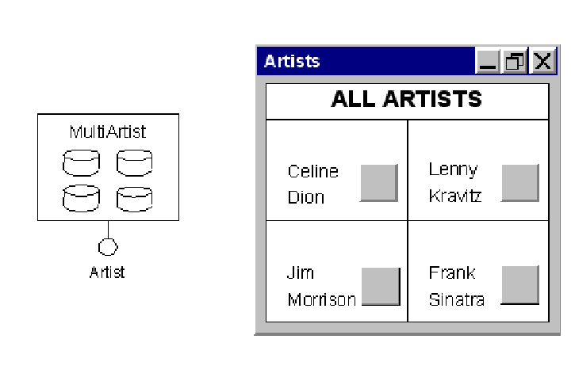
Hypertext Modeling : Units
WebML graphic notation for multidata units, and rendition in HTML.
Textual Definition
DataUnit ShortArtist
(source Artist;
selector FirstName="Celine", LastName="Dion";
attributes FirstName, LastName, Photo)
Multidata units present multiple objects of an entity together, by repeating the presentation of several
data units.

Slide 32
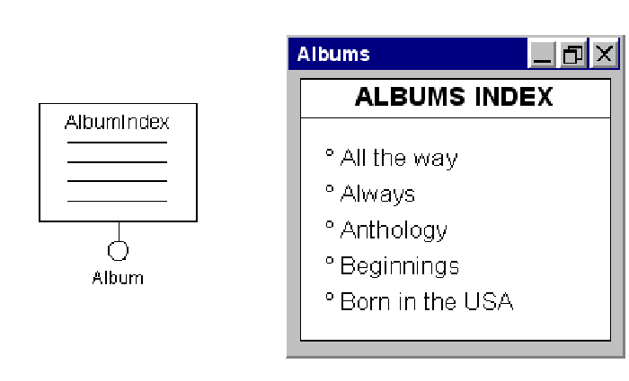
Hypertext Modeling : Units
WebML graphic notation for index units, and rendition in HTML.
Textual Definition
IndexUnit AlbumIndex
(source Album;
attributes Title;
orderby Title)
Index units present multiple objects of an entity as a list. Albums are displayed using only the title attribute, and presented in ascending order by title.

Slide 33
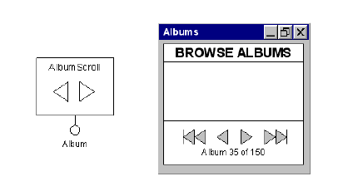
Hypertext Modeling : Units
WebML graphic notation for scroller units, and rendition in HTML.
Textual Definition
ScrollerUnit AlbumScroll
(source Album;
blockFactor 1;
orderby Title)
Scroller units provide commands to scroll through the objects in a set, for example to scroll over all
the instances of an entity.

Slide 34
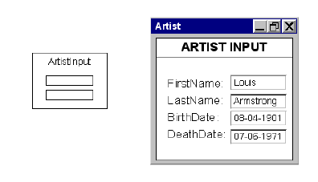
Hypertext Modeling : Units
WebML graphic notation for entry units, and rendition in HTML.
Textual Definition
EntryUnit ArtistInput
(fields
FirstNameField String;
LastNameField String;
BirthDateField Date;
DeathDateField Date)
Entry units support form-based data entry.

Slide 35
Hypertext Modeling : Units
WebML graphic notation for entry units, and rendition in HTML.
Textual Definition
EntryUnit ArtistInput
(fields
FirstNameField String;
LastNameField String;
BirthDateField Date;
DeathDateField Date)
Entry units support form-based data entry.

Slide 36
Hypertext Modeling : Pages
Pages are the actual interface elements delivered to the user, who browses the hypertext by accessing its pages in the desired sequence.
A page typical consists of several units, grouped together to accomplish a well-defined communication purpose.

Slide 37
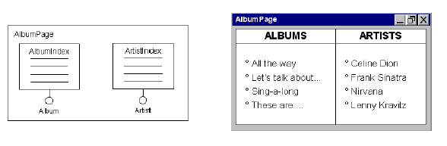
Hypertext Modeling : Pages
The figure shows the graphic notation for pages, which is simply a labeled box surrounding the units that belong to the page. In the example, the page called AlbumPage contains two index units, one for displaying the list of all artists, and one for displaying the list of all albums.
Textual Syntax
Page AlbumPage
(units AlbumIndex, ArtistIndex)
WebML graphic notation for pages.

Slide 38
Hypertext Modeling : Links
Hypertexts are made of connected pages, which contain several interrelated pieces of content and commands permitting the user to interact with the application.
Navigation modeling is the part of hypertext modeling that deals with the specification of the links between units and pages, and of the properties of such links.
Navigation modeling includes:
  Link –
    A link is an oriented connection between two units or pages.
  Link parameter
    A link parameter is the specification of a piece of information, which is transported from the source to the destination of the link.

Slide 39
Hypertext Modeling : Links
In the WebML terminology, links crossing the boundaries of pages are called inter-page links.
Links with the source and destination inside the same page are called intra-page.
Links transporting information are called contextual, in contrast with non-contextual links, which do not transport information.

Slide 40
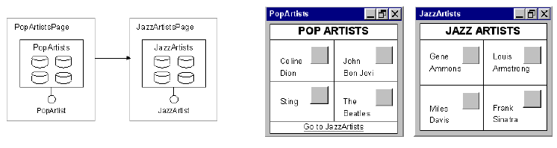
Hypertext Modeling : Links
Non-contextual link.
Textual Definition
link PopToJazz
(from PopArtistsPage to JazzArtistsPage)

Slide 41
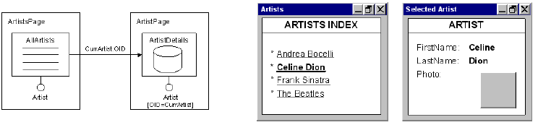
Hypertext Modeling : Links
Contextual link.
Textual Definition
link ToArtistsDetails
(from AllArtists to ArtistDetails;
parameters CurrArtist:OID)

Slide 42
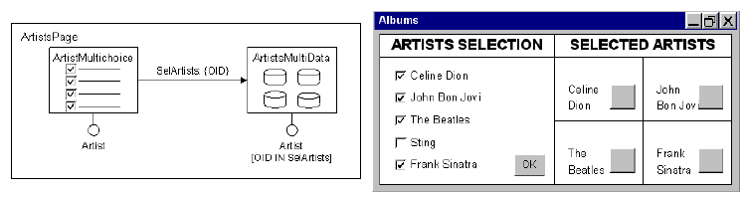
Hypertext Modeling : Links
Multi-choice index and set-valued link parameter.
Textual Definition
link ToArtistsDetails
(from ArtistMultiChoice to ArtistsMultiData;
parameters SelArtists:{OID})

Slide 43
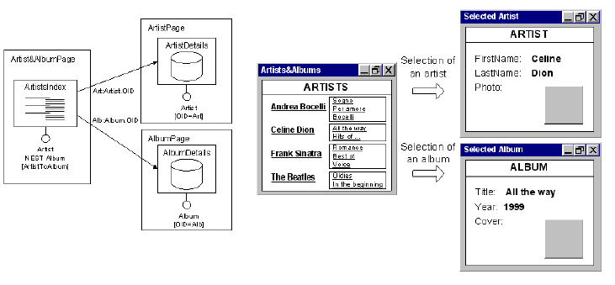
Hypertext Modeling : Links
Hierarchical index with two outgoing links with different link parameters.

Slide 44
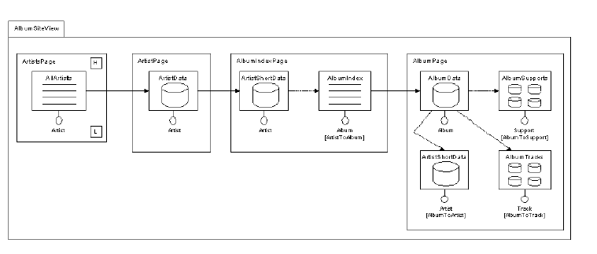
Hypertext Organization : Site View
A WebML hypertext is packaged into an application to be delivered to users by enclosing its linked pages and units into a modularization construct called site view.
Textual Definition
link PopToJazz
(from PopArtistsPage to JazzArtistsPage)

Slide 45
Content Management Model
Content management is often used to refer to the process of handling information presented. It also refers to the process of capturing, storing, sorting, codifying, integrating, updating and protecting any and all information.

Slide 46
CMM - Operations
Models a content manipulation operation.
Input from one or more incoming links.
Two kinds of output links:
  OK link if the operation completes correctly
  KO link if the operation fails

Slide 47
CMM - Operations
WebML predefines a set of frequently used built-in operations to manage a site’s content.
They are the traditional database operations: create, delete, modify, create relationship, delete relationship.
Users do not need to define the behaviour and the implementation; they are provided off-the-shelf in the model.

Slide 48
CMM – Build in Operation
CREATE
DELETE
MODIFY
Create Unit
Delete Unit
Modify Unit
Entity
Entity
Entity
CONNECT
DISCONNECT
Connect Unit
Disconnect Unit
relationship
relationship

Slide 49
CMM : Create
value1→ attribute1
Nothing
KO
Create Unit
OID of
the new object
OK
value2 → attribute2
Entity

Slide 50
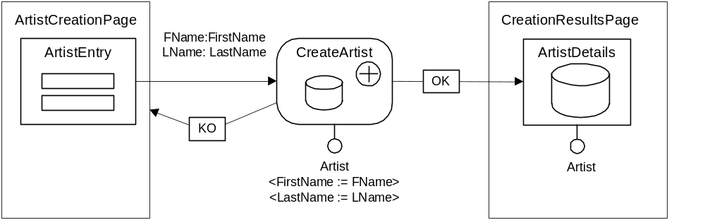
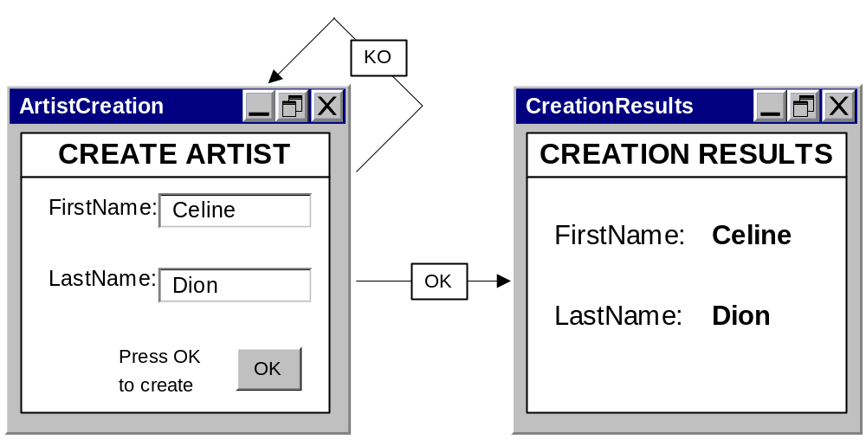
CMM : Create

Slide 51
CMM : Modify
Identifier(s) of the
object(s) to modify
value1 → attribute2
Value2 → attribute1
KO
Modify Unit
OK
Identifier(s) of the
modified object(s)
OIDs of objects to modify
Entity

Slide 52
CMM : Delete
KO
OIDs of the
object(s) to delete
Delete Unit
OK
Nothing
Entity

Slide 53
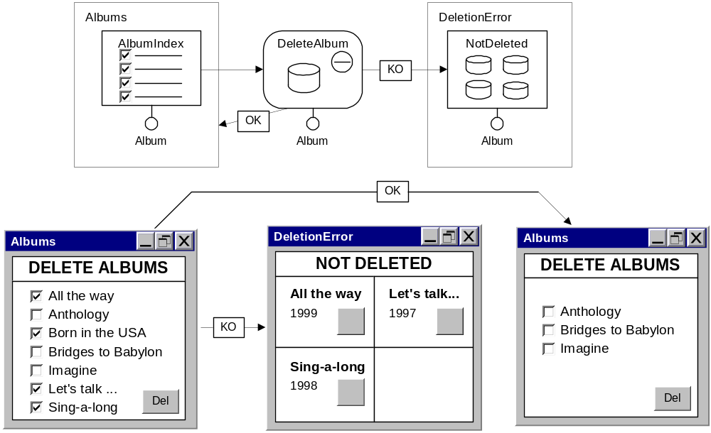
CMM : Delete

Slide 54
Access Rights & Personalization
WebML is typically used for designing applications serving the needs of multiple user communities.
Site views permit the definition of several hypertexts on top of the same data, each addressing the requirements of one or more user groups.
WebML distinguishes two classes of users:
  Registered users.
  Non-registered users.

Slide 55
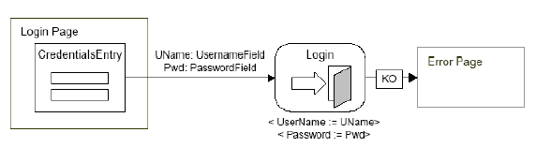
Logout Operation
Credential verification for accessing protected site views is modeled by a WebML operation called login, which is used to establish the identity of a user who is accessing the site, and address him to the home page of the site view associated to his default group.
Textual Definition
login LoginOperation
(parameters UserName:UName, Password:Pwd)
WebML login unit preceded by an entry unit for credential input.

Slide 56

Logout Operation
The logout operation is used to “forget” the session of a logged user, and forward him to a default page with no access control.
Textual Definition
logout LogoutOperation
Logout operation unit, invoked via a non-contextual activating link.

Slide 57
Q & A

